Slide 1
For printing - idea-t workshop A3 mind map skeleton for TestBash Brighton 2025 copies for sharing 1 between 3 or 4
Isabel Evans
idea-t v2 August 2025
Notes: Slide size set to A3 (A3 paper size landscape) for printing
Available as an Xmind file (https://github.com/hci-lab-um/heuristics-for-test-tool-design/blob/v2/Downloads/idea-t-mindmap-skeleton.xmind)
Use this to start the conversation around the idea-t heuristics. The three theme branches have been started, for you to complete in context. There are QR codes to sections of the idea-framework on GitHib for you to explore further and gain hints and tips about what to consider when answering the questions.
An accessible version of the mind map skeleton branches is in the slide notes and also available as a word document to download from the idea-t repository (add link).

Slide 2
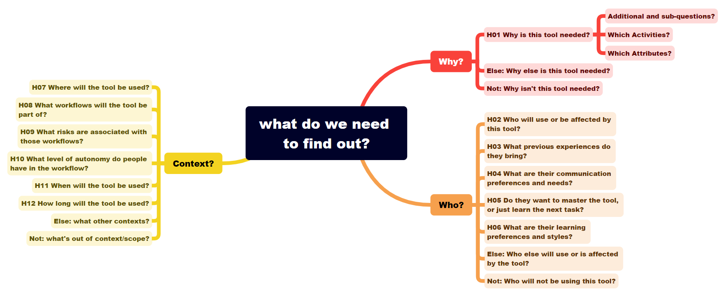












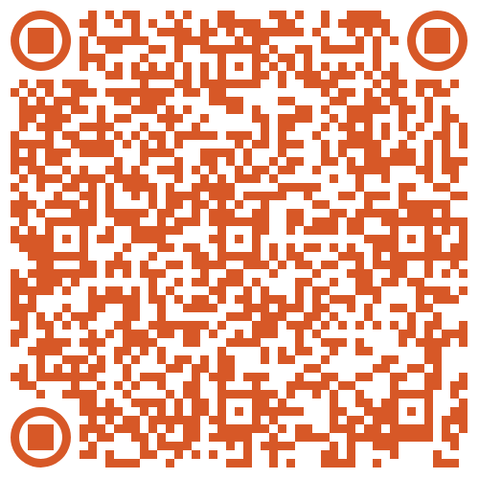





Idea-t mind map starter for TestBash October 2025 Workshop
Influencing the design-evaluation and acquisition of tools to support testing
These QR codes link to idea-t v2 draft structures and downloads
These QR codes link to v1.7 content (transfer to v2 still in progress…)
Idea-t v1.7
README page
Quick Start
page
Mind map
Xmind starter
Idea-t v2
ReadMe
page
Quality
attributes
Why?
Who?
Context?
H01
Why?
H02
Who?
H03
Experiences?
H04
Communication
H05
Mastery
or task ?
H06
Learning
style?
H07
Where?
H08
Workflows?
H09
Risks
H10
Autonomy?
H11
When?
H12
How long?
Quick Start
download
Mind map starter: bulleted list
QR code
QR code
QR code
QR code
QR code
QR code
QR code
QR code
QR code
QR code
QR code
QR code
Idea-t framework is based on research by Isabel Evans, University of Malta and is available under a GPL 3.0 license. The repository for the idea-t framework is at https://github.com/hci-lab-um/heuristics-for-test-tool-design/blob/main/README.md
Notes:
TestBash Workshop:– Bullet List version of mind map
This document is the mind map on the idea-t mind map poster, presented as a bullet list. Bullet level 1 is the centre of the mind map. Bullet level 2 is a main branch. Bullet level 3 is a subbranch. For the workshop about idea-t and on the mind map poster, only the starting skeleton of the mind map is shown, allowing teams to build their own mind map detail.
Under the subbranch “H01 Why is this tool needed?” three subbranches (starting -) at heading level 4 are shown. These could appear in every branch of the mind map, but are just shown here in the skeleton map as examples. At the end of each main branch are * Else and * Not options – again this can be used in all the sub branches as needed.
What do we need to find out?
- 1 Why?
1.1 H01 Why is this tool needed?
- Additional and sub-questions?
- Which activities?
- Which attributes?
* Else: Why else is this tool needed?
* Not: Why isn’t this tool needed?
- 2 Who?
2.1 H02
2.2 H03
2.3 H04
2.4 H05
2.5 H06
* Else:
* Not:
- 3 Context?
3.1 H07
3.2 H08
3.3 H09
3.4 H10
3.5 H11
3.6 H12
* Else:
* Not:

